Slide 1
3.4 Network hardware
Media access control (MAC) address

Slide 2
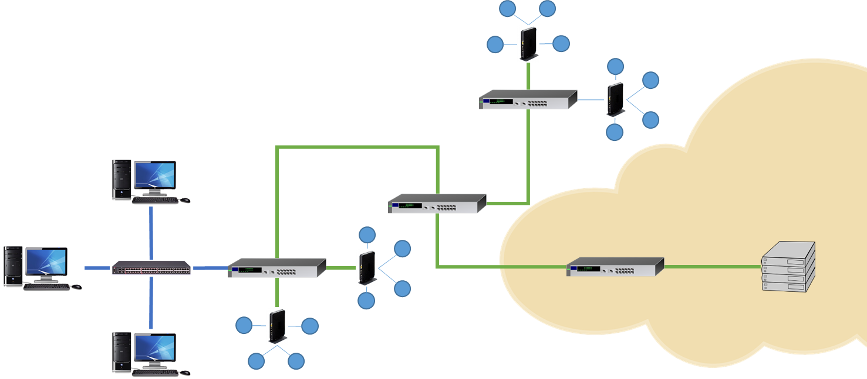
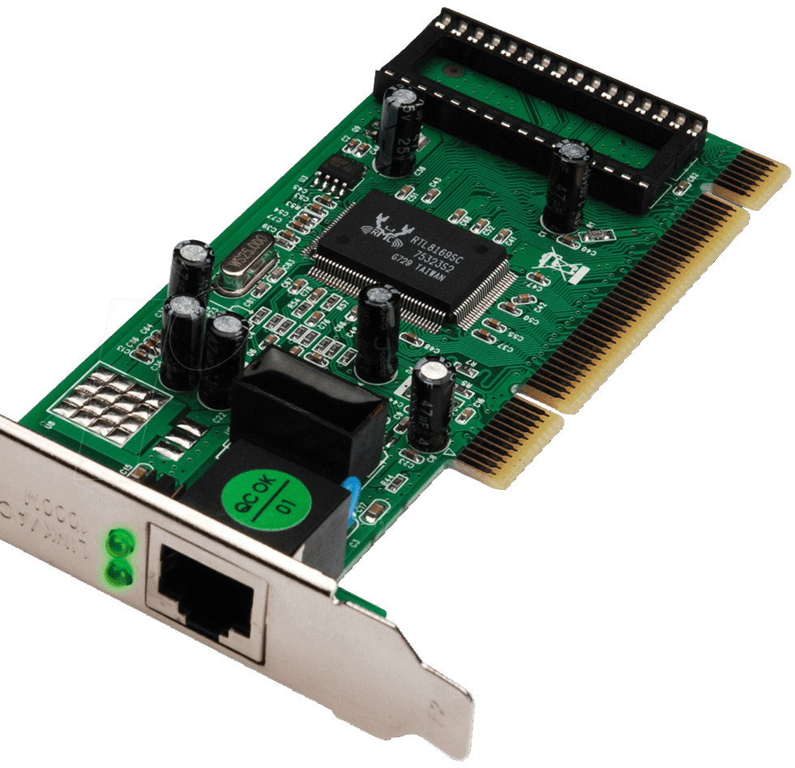
MAC addressing
Every device on a network has a network interface card (NIC).

Slide 3
MAC addressing
Every device on a network has a network interface card (NIC).
Every NIC has a media access control (MAC) address, which is used to route frames on a local area network (LAN).
00:0a:95:9d:68:16

Slide 4
MAC addressing
If the LAN is connected to a WAN such as the internet, a different addressing method is required.
IP addressing is used to route frames on a wide area network (WAN) – with a WAN, we refer to frames as packets.

Slide 5
MAC addressing
A MAC address is made up of 48 bits.
0010 1010 - 1011 0011 - 0001 1001 - 1111 0110 - 1000 0010 - 1100 1101

Slide 6
MAC addressing
A MAC address is made up of 48 bits.
To make them easier to read, we typically represent this as six groups of hexadecimal digits.
2A – B3 – 19 – F6 – 82 – CD
0010 1010 - 1011 0011 - 0001 1001 - 1111 0110 - 1000 0010 - 1100 1101

Slide 7
MAC addressing
A MAC address is made up of 48 bits.
To make them easier to read, we typically represent this as six groups of hexadecimal digits.
2A – B3 – 19 – F6 – 82 – CD
The first six hex digits (3 bytes) represent a unique manufacturer code
The second six hex digits (3 bytes) represent the unique serial code for the device

Slide 8
MAC addressing
While the IP address assigned to a device can change, the MAC address assigned to a NIC is:
Unique
Static
Set by the manufacturer
If the NIC is replaced, the MAC address will also change.
2A – B3 – 19 – F6 – 82 – CD
The first six hex digits (3 bytes) represent a unique manufacturer code
The second six hex digits (3 bytes) represent the unique serial code for the device

Slide 9

Media Access Control (MAC) address
MAC addressing is used to route frames on a local area network (LAN).
Each MAC address is unique to every network interface card (NIC).
MAC addresses are static and assigned by the manufacturer.
A MAC address is 48 bits in length.
MAC addresses are represented as six groups of hexadecimal digits (e.g., 00:0a:95:9d:68:16).
The first six hex digits (3 bytes) represent a unique manufacturer code.
The second six hex digits (3 bytes) represent the unique serial code for the device

Slide 10


